Slide 1
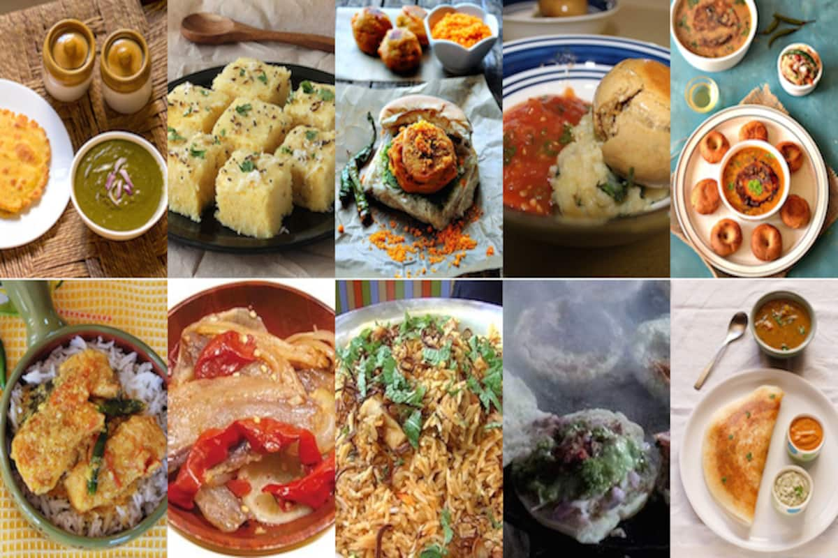
GRAND LALIT HOTEL WE ARE HIRING A CHEF !!!
BORED WITHOUT WORK , COME WORK WITH US .
THE CHEF MUST KNOW MORE THAN 15 CUISINES .
HE/SHE SHOULD HAVE MORE THAN 3 YEARS OF COOKING EXPERIENCE .
FOR ANY QUERIES , PLEASE CALL US ON:
9856420981
OR
EMAIL ON - LALIT.COOKING@GMAIL.COM
HE/SHE CAN APPLY FOR THE JOB ON THE SAME MAIL OR CAN CALL ON THE GIVEN NUMBER .
BY ADVITYA BHATIA

